Slide 1
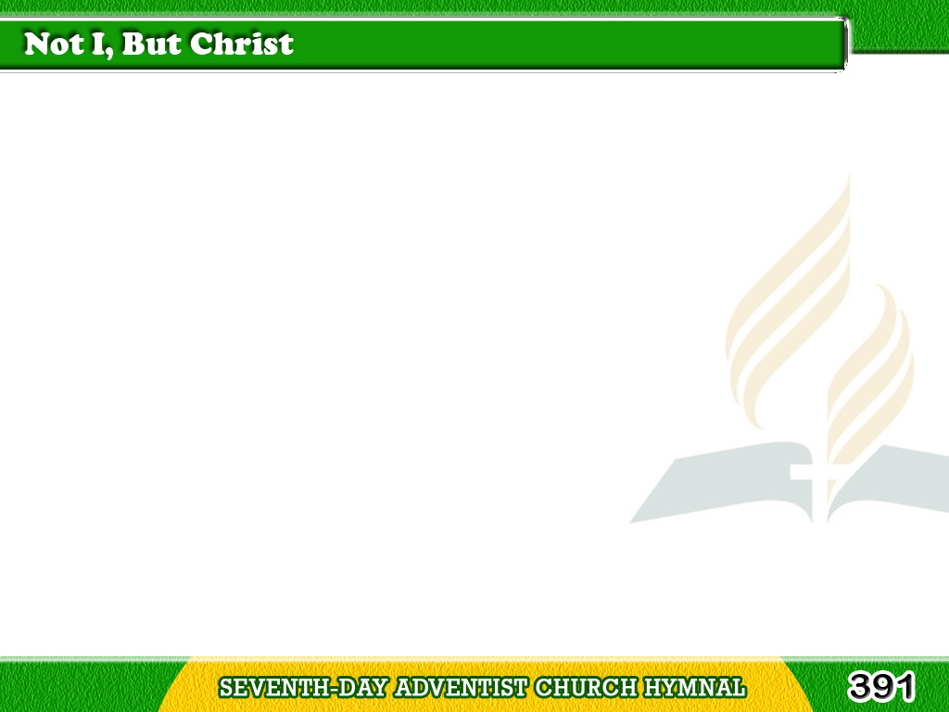
1/4
Not I, but Christ,
be honored, loved, exalted;
Not I, but Christ,
be seen, be known, be heard;
Tagalog
Version

Slide 2
1/4
Not I, but Christ,
in every look and action,
Not I, but Christ,
in every thought and word.
Tagalog
Version

Slide 3
2/4
Not I, but Christ,
to gently soothe in sorrow,
Not I, but Christ,
to wipe the falling tear;
Tagalog
Version

Slide 4
2/4
Not I, but Christ,
to lift the weary burden,
Not I, but Christ,
to hush away all fear.
Tagalog
Version

Slide 5
3/4
Christ, only Christ!
no idle words e’er falling,
Christ, only Christ;
no needless bustling sound;
Tagalog
Version

Slide 6
3/4
Christ, only Christ;
no self important bearing;
Christ, only Christ;
no trace of “I” be found.
Tagalog
Version

Slide 7
4/4
Not I, but Christ,
my every need supplying,
Not I, but Christ,
my strength and health to be;
Tagalog
Version

Slide 8
4/4
Christ, only Christ,
for body, soul, and spirit,
Christ, only Christ,
here and eternally.
Tagalog
Version

